Slide 1
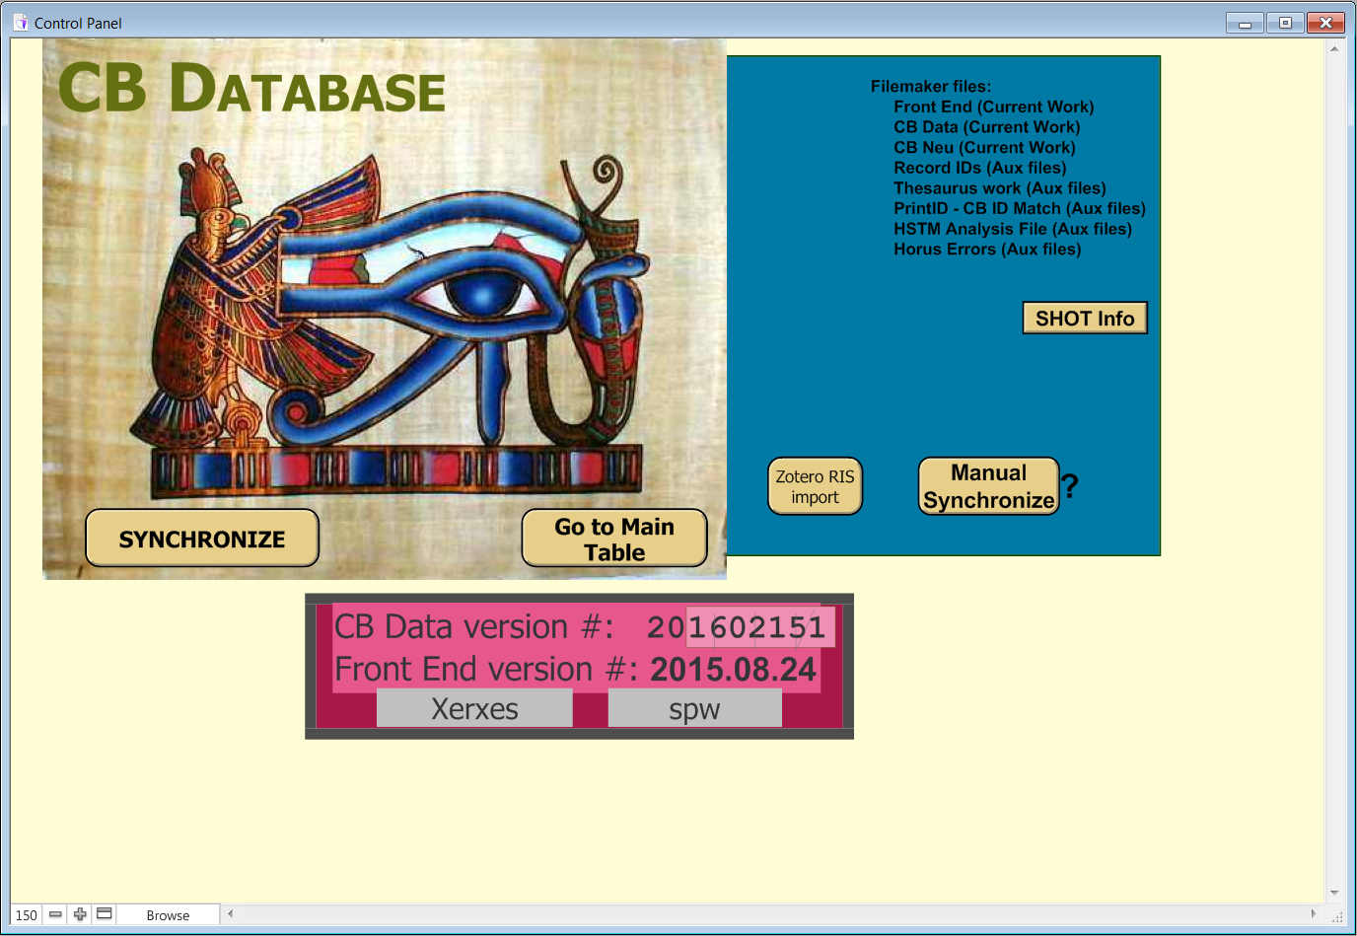
IsisCB System 2002: Control Panel (Opening Layout)

Slide 2
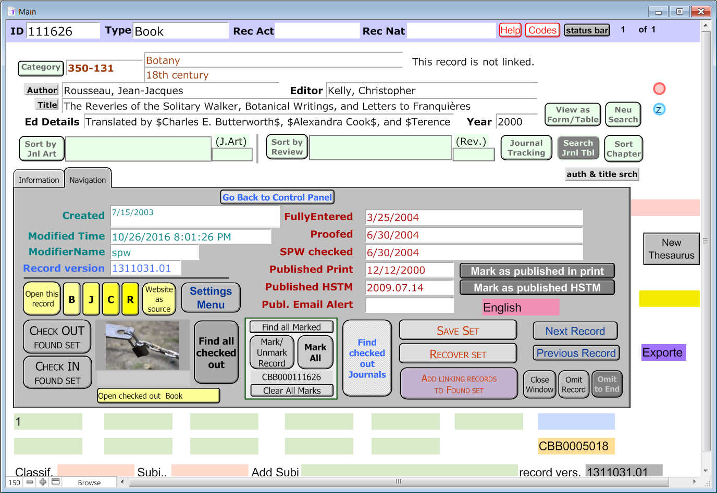
IsisCB System 2002: Main Table Layout

Slide 3
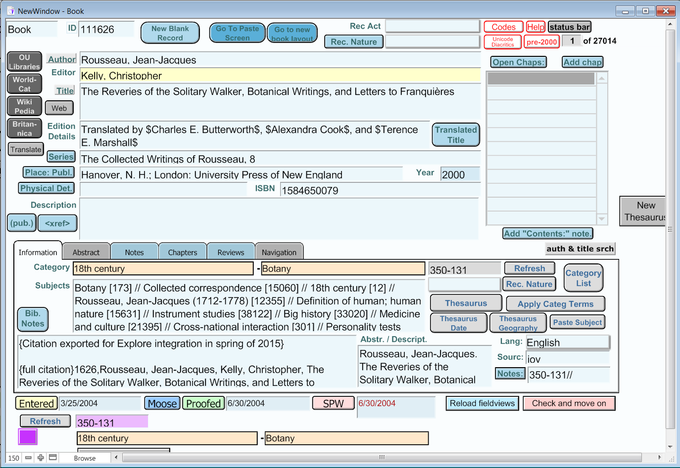
IsisCB System 2002: Book Citation Layout

Slide 4
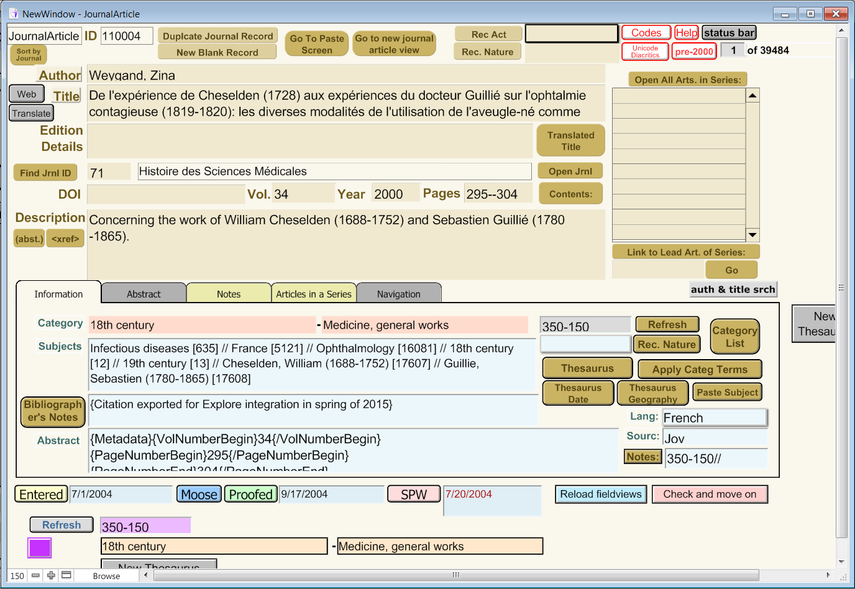
IsisCB System 2002: Journal Article Citation Layout

Slide 5
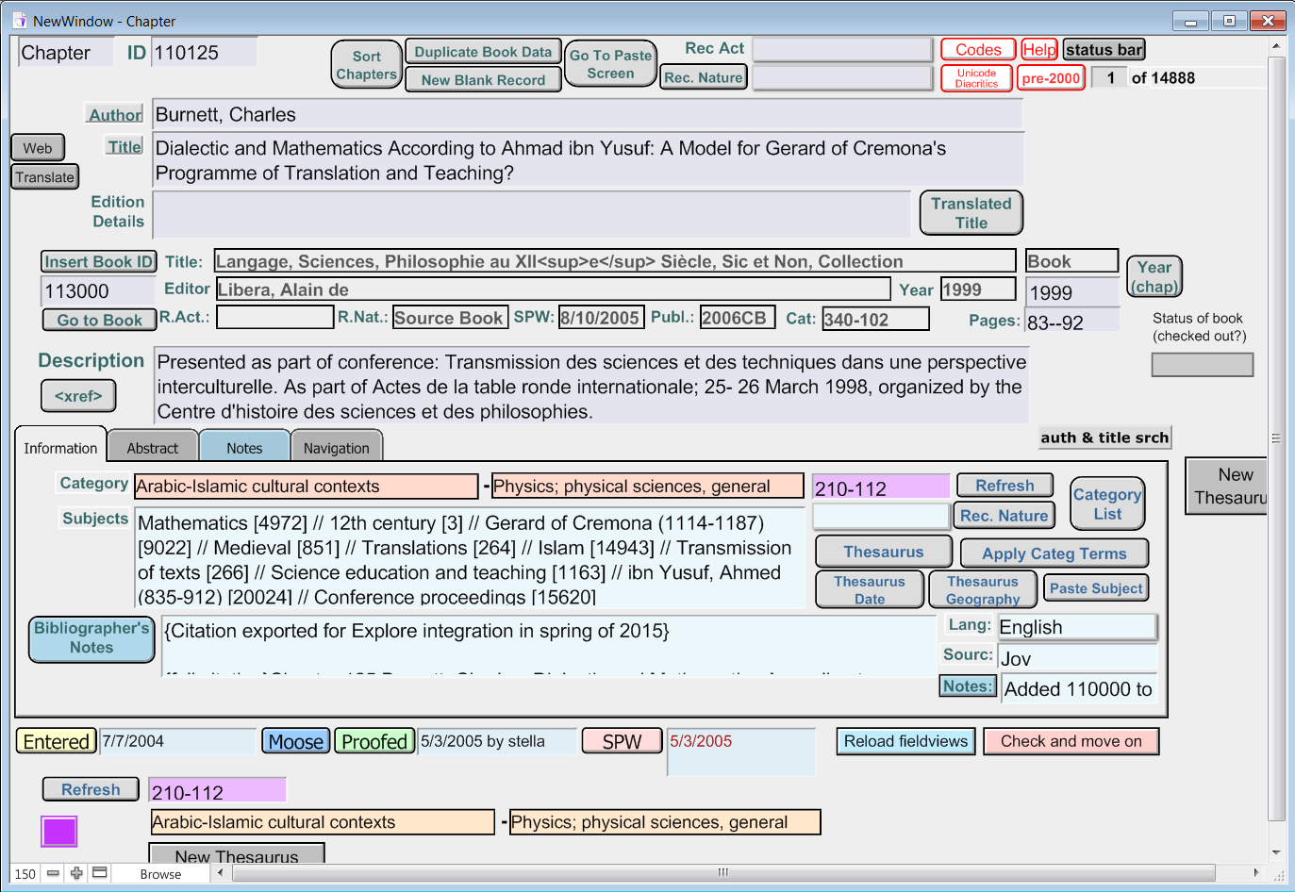
IsisCB System 2002: Chapter Citation Layout

Slide 6
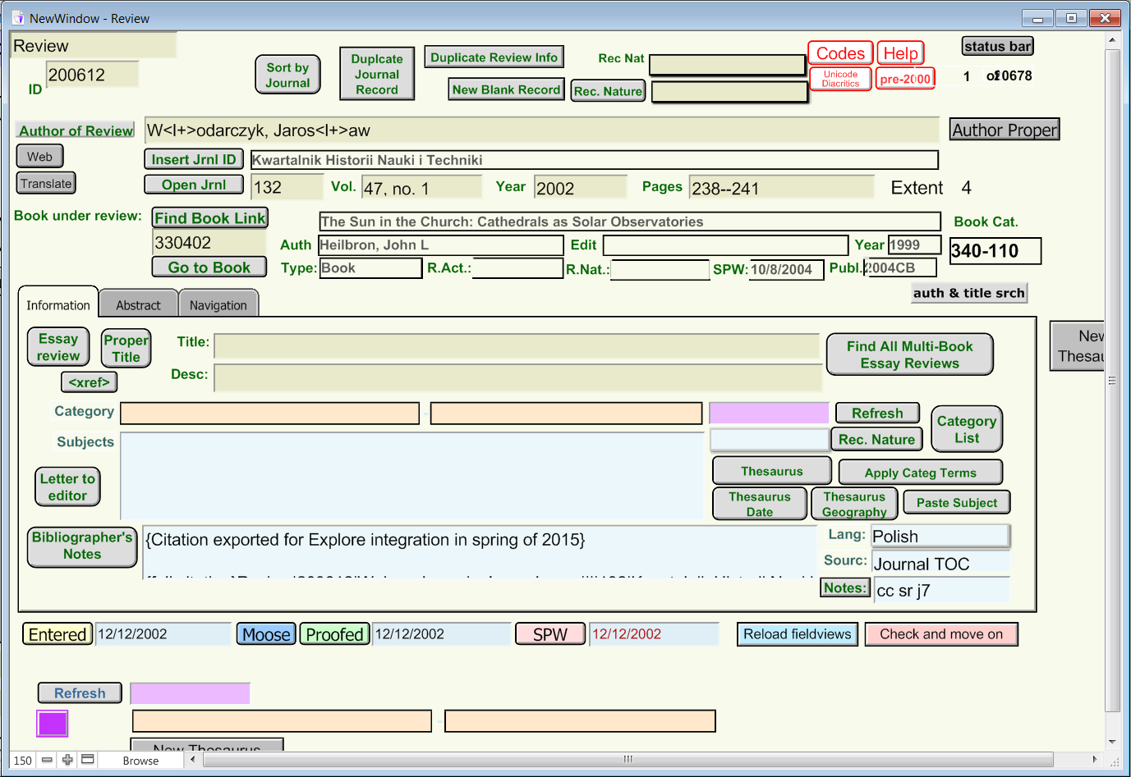
IsisCB System 2002: Book Review Citation Layout

Slide 7
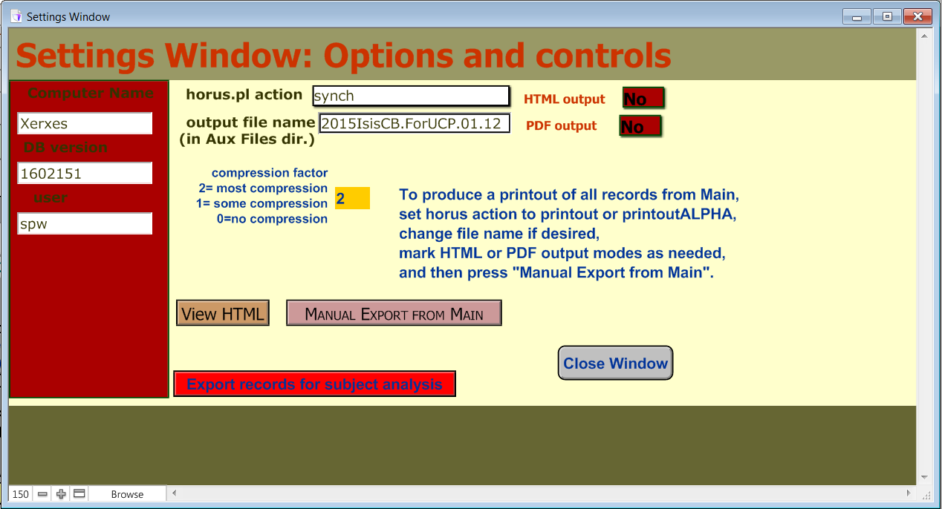
IsisCB System 2002: Settings Window Layout

Slide 8
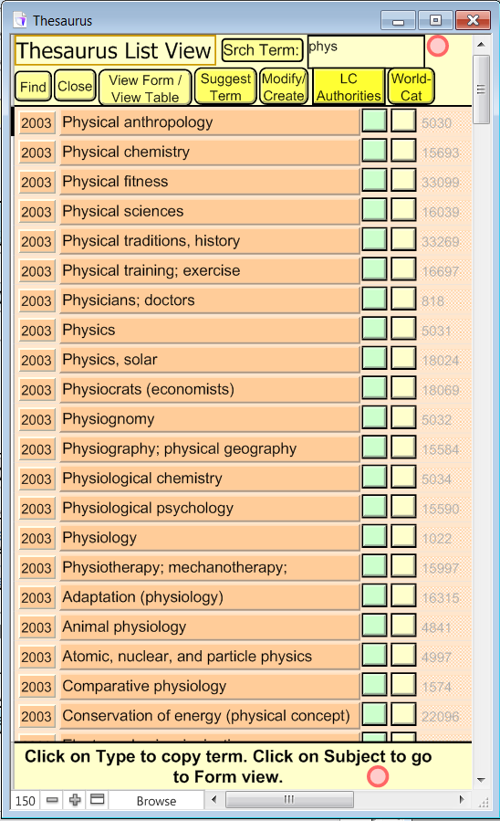
IsisCB System 2002: Thesaurus Input Layout

Slide 9
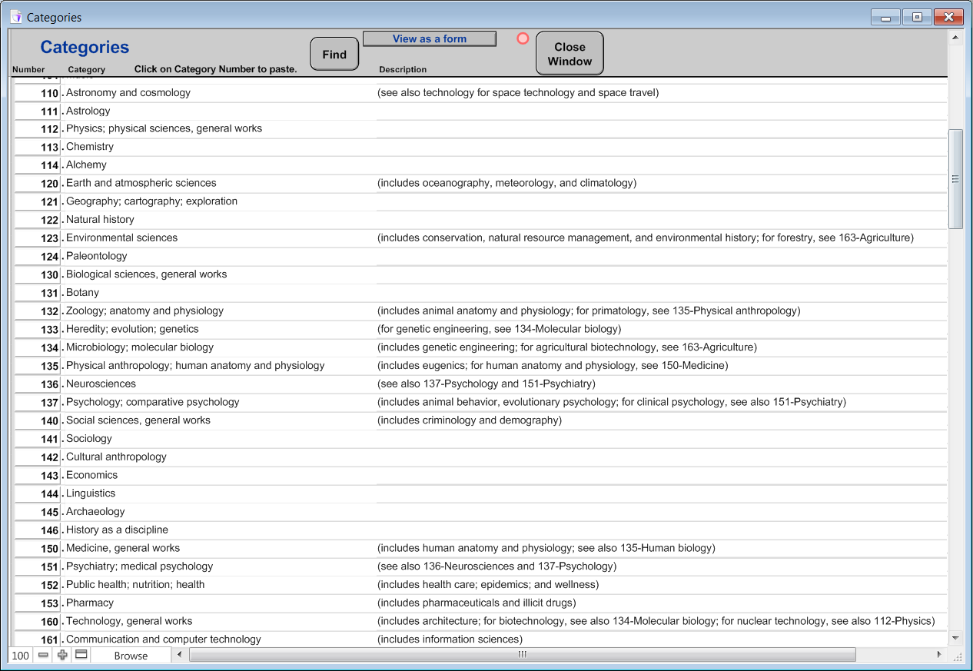
IsisCB System 2002: Classification Category List Layout

Slide 10
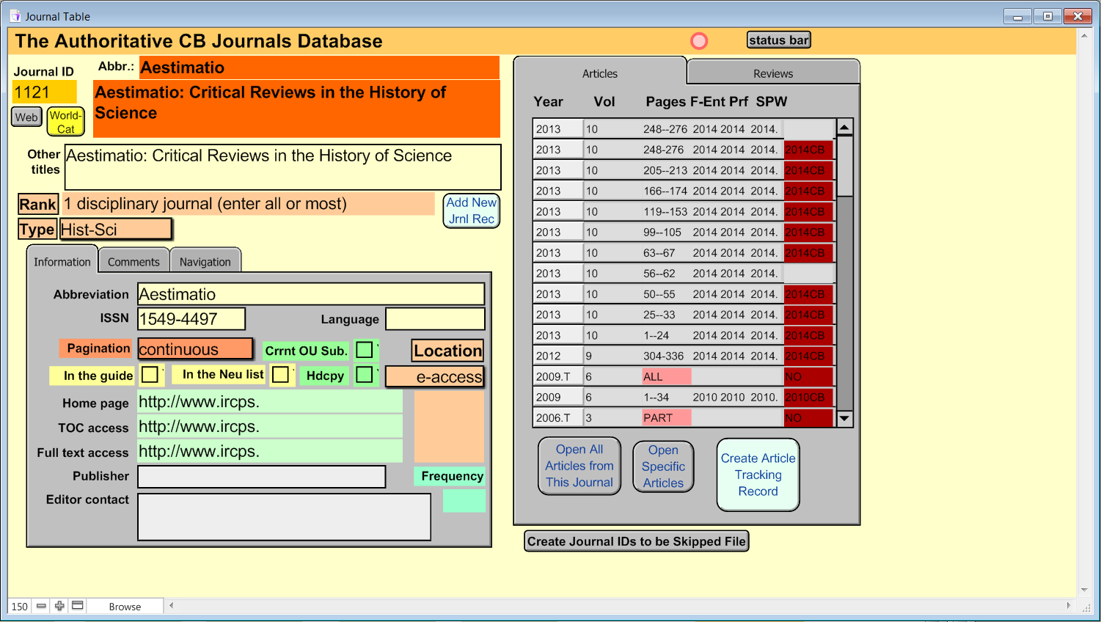
IsisCB System 2002: Journals Database Layout

